Slide 1

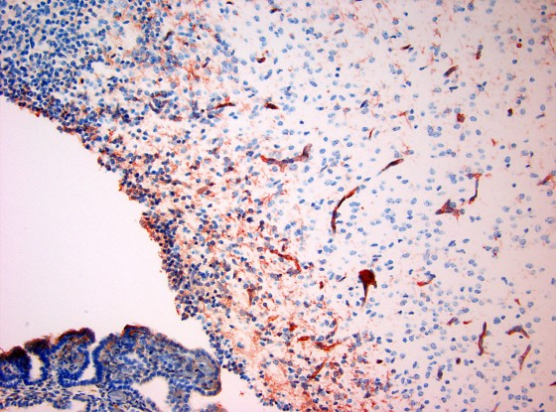
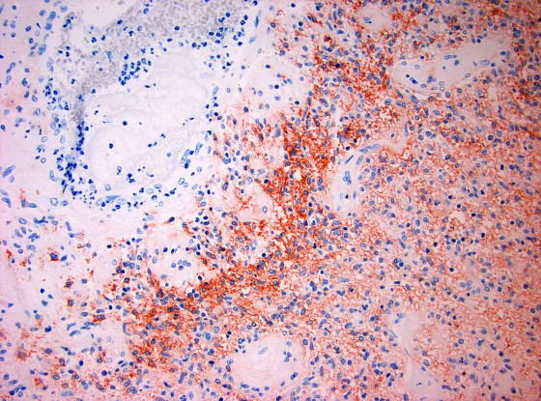
ReliaTech GmbH
Anti-mouse VEGF-A
(Paraffin-embedded sections; Cat #103-PA03S/-PA03)
Mouse E17: ventricular zone of the CNS
Human Glioblastoma: perinecrotic area
The experiments were performed by Dr. Till Acker and Prof. K.H. Plate,
Neurological Institute, Neuropathology, Deutschordenstr. 45, 60528 Frankfurt, Germany
http://www.reliatech.de / orders@reliatech.de

